Slide 1


Introduction to Operating Systems CS 1550
Spring 2023
Sherif Khattab
ksm73@pitt.edu
(Some slides are from Silberschatz, Galvin and Gagne ©2013)

Slide 2
Announcements
Lab 0 due next Friday
soft deadline; not graded; no deliverables
Homework 1 will be posted on Canvas this Friday
3 attempts
A practice homework with unlimited attempts
Special for Homework 1
Recitations start next week
VS Code setup tutorial on Piazza
(also linked from Canvas)
Draft Slides repo linked from Canvas

Slide 3
Agenda
Main tasks of an operating system
System Calls
What an interrupt is
What happens when an interrupt occurs
What a system call is
How system calls implemented
Effect of OS structure on system calls

Slide 4
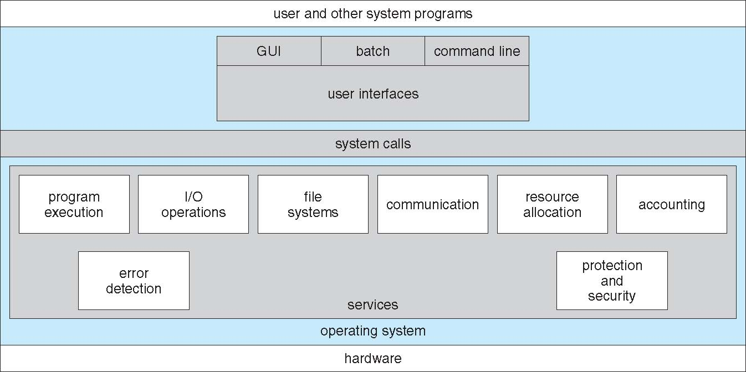
System Calls

Slide 5
System Calls
Programming interface to OS services
Typically written in a high-level language (C or C++)
Mostly accessed by programs via a high-level Application Programming Interface (API) rather than direct system call use
Win32 API for Windows
POSIX API for POSIX-based systems (including virtually all versions of UNIX, Linux, and Mac OS X), and
Java API for the Java virtual machine (JVM)

Slide 6
System Call Implementation
Typically, there is a number associated with each system call
Each system call has a corresponding system call implementation function (part of the OS kernel)
System-call table indexed according to these numbers
Each entry in the table contains the address of the corresponding system call implementation function
The system call interface is the ISR corresponding to the syscall software interrupt
invokes the intended system call in OS kernel,
passes arguments if needed, and
returns status of the system call and any return values
The caller need know nothing about how the system call is implemented

Slide 7
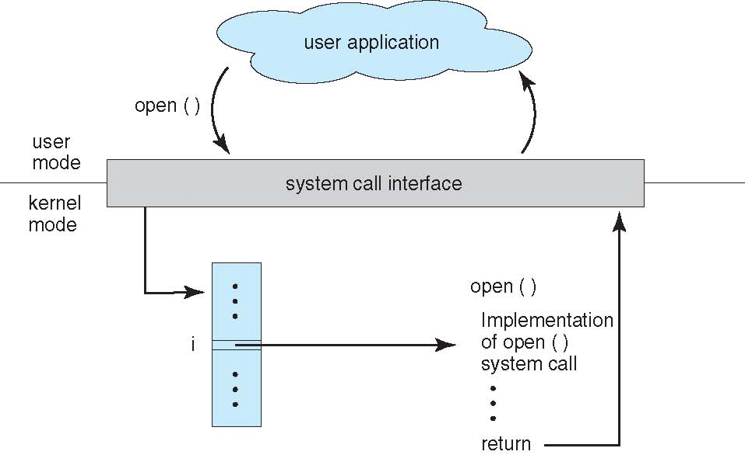
API – System Call – OS Relationship

Slide 8
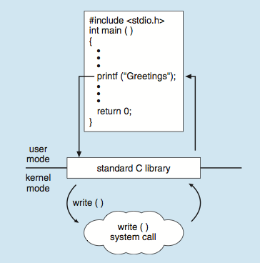
Standard C Library Example
C program invoking printf() library call, which calls write() system call

Slide 9
What happens on a syscall?
2
1
7
6
12
1
eax <-- 1
10
3
int 64
5
4
11
8
9
Step 10: The syscall handler of the write syscall returns back to f7()
f7() executes the return from interrupt instruction
An application wants to display a message on the screen
Step 4: CPU switches mode to kernel mode
Step 1-2: Put the value 1 in the EAX register
Step 3: Application executes the int 64 instruction
int 64 triggers an interrupt
CPU looks up the address of IDT table inside the IDT register
Step 9: The syscall handler of the write syscall is executed
CPU is still in kernel mode
Step 7: Entry 64 in IDT contains the address of ISR f7()
CPU starts executing the code in f7
Assumptions
The interrupt number for system calls is 64
The system call number for writing to screen is 1
Step 11-12: PC value restored from kernel stack
CPU switches back to user mode
Execution of the application resumes in user mode
Step 5-6: PC register is saved to kernel stack then loaded from entry 64 in the IDT table
Step 8: The call syscalls[EAX] instruction is executed
CPU loads the address inside entry EAX (1) of syscall table into PC

Slide 10
System Call Parameter Passing
Three general methods used to pass parameters to the OS
Simplest: pass the parameters in registers
In some cases, may be more parameters than registers
Parameters stored in a block, or table, in memory, and address of block passed as a parameter in a register
This approach taken by Linux and Solaris
Parameters placed, or pushed, onto the stack by the program and popped off the stack by the operating system
XV6
Block and stack methods do not limit the number or length of parameters being passed

Slide 11
How to add a system call to an OS?

Slide 12
Xv6 Code Walkthrough
IDT table initialization
Syscall table
How a syscall is invoked
Syscall implementation
Parameter passing into a syscall
In Lab 1 you will add a system call to Xv6

Slide 13
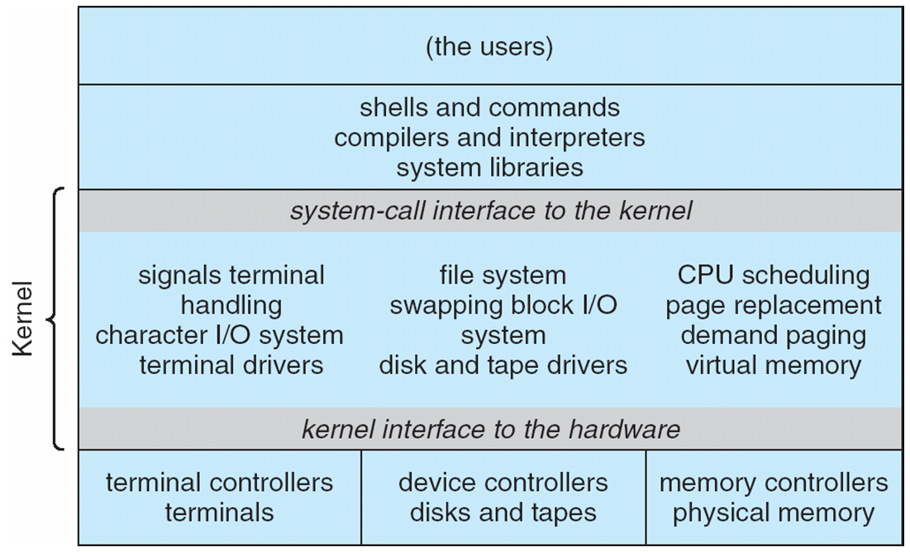
Traditional UNIX System Structure
Beyond simple but not fully layered

Slide 14
Microkernel System Structure

